Slide 1
Content
Project Description
Architecture
Input Structure
Phi Structure
Algorithm(MF\EMF)
Algorithm(Topological Sort)
Related Technology Description
Recap and Improvements
Demo in Action

Slide 2
Project Description
Problem
There is a poor performance of the query processing in standard SQL when it comes to complex relational algebraic expressions with multiple joins, group-bys, and sub-queries.
Solution
There is a need to extend a syntactic framework by adding such that clause which will be processed by efficient and scalable algorithm.
Technical significance
Compared to standard SQL:
A.The program saves scans and joins
B.The program can perform 2 scans in 1 query which has no dependency.

Slide 3
Architecture
Input
6 operands
File1.txt
PhiStructure
(6 corresponding lists)
Functions
(for Processing
PhiStructure)

Slide 4
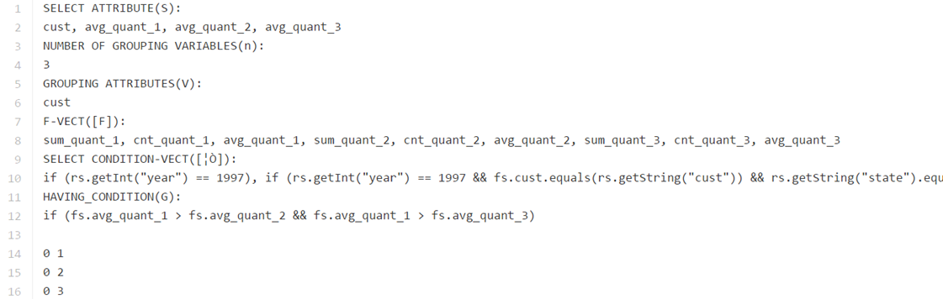
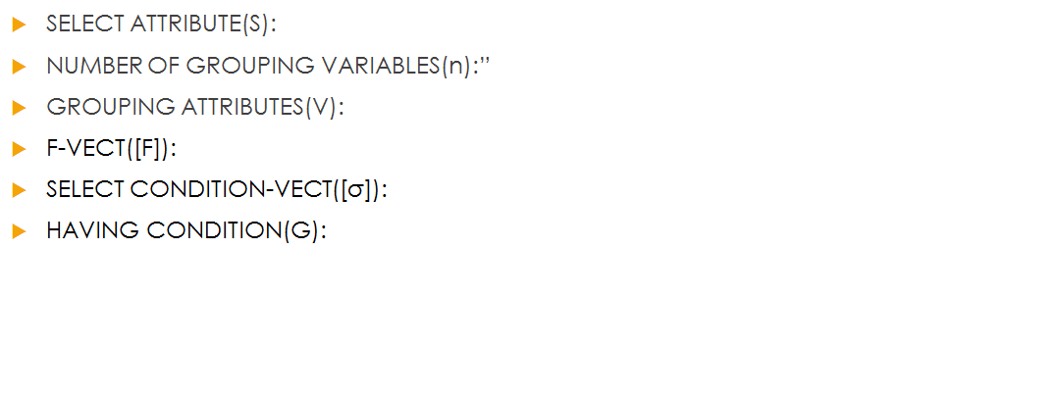
Input Structure Haichen Zhu

Slide 5
PhiStructure Svyatoslav Turets
Original Notations | Corresponding Fai Class Properties in Project | Fai Class Functions
S: Attributes and Aggregations needed to be outputted | List<String> projAttri_S; | getProjAttri_S(), setProjAttri_S(List<String> projAttri_S)
G: Having Clause | List<String>havingCondition_G; | getHavingCondition_G(),setHavingCondition_G(List<String> havingCondition_G)
V: Grouping Attributes | List<String> ga_V; | getGa_V(),setGa_V(List<String> ga_V)
N: Number of Grouping Variables | Integer numGV_N; | getNumGV_N(),setNumGV_N
F: A List of Aggregate Functions | List<String> af_F; | getAf_F(),setAf_F(List<String> af_F)
ϴ:A List of all Predicates | List<String> selectCondition_Q; | getSelectCondition_Q(),setSelectCondition_Q(List<String> selectCondition_Q)

Slide 6

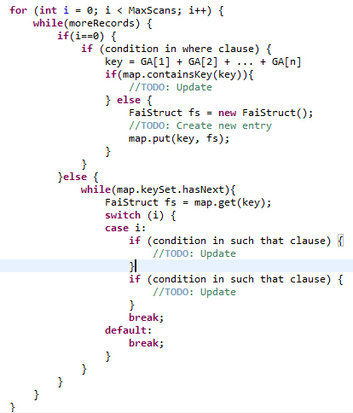
Algorithm (MF\EMF) Han Wang
Print out code for(In source code):
1. Generating maximum number of loops
2. First scan(generating MF structure)
2.1 Match condition statement in such that clause
(condition in "where" clause)
2.2 Generating key(based on grouping attributes -> Hashmap)
2.3 If mf-struct contains key, update AF for grouping variable 0
2.4 If mf-struct !contains key, create new entry
3. 2-n scans(including dependency control), and for each scan:
3.1 Retrieve mf-struct(Hashmap) to get entries
3.1 Match condition statements in such that clause to relative
entries, and update
4. Outputing result
sum_quant_2
split(“_”)
sum
quant
2

Slide 7
Algorithm(Topological Sort) Yubin Shen
Topological Sort:
In one sentence, topological sort means we do all the aggregate functions with no dependency(or indegree) in each loop.
Implementation: build a graph for topological sort (Graph.java) adjaceList
number of the nodes = number of grouping variables + 1
edges shows in Input file
Algorithm description:
for each loop, find out all the nodes with no indegree and then print the related select
conditions. When it’s done, delete these nodes and edges in graph and refresh the
indegree for all left nodes.

Slide 8
Related Technology Description
Language: Java(JDK7)
DBMS: PostgreSQL, JDBC
No external libraries
Technical Limitation:
No error checking for presence of tables, columns, input files etc.
Can’t process calculation for select attribute

Slide 9
Recap and Improvement
The program is able to process the queries more efficiently and succintly by using our project.
Recommended Performance Improvements :
Parallel Processing by using multi-threading.
Using more efficient expression as input file. (such that clause)
More scan ,less memory

Slide 10
Let’s See It in Action

